Slide 1

Computer registers; Common bus system
Computer Organization and Architecture | Register Organization
Course: Computer Organization and Architecture | Chapter: Register Organization | Program: Bachelor of Engineering
DISCOVER · LEARN · EMPOWER
Notes:
Welcome everyone to today's lecture on Register Organization. We will focus specifically on the internal structure of registers and how they communicate via a common bus system. This is a foundational topic for understanding how the CPU processes data efficiently. Let us begin by mapping our learning outcomes to the course goals.

Slide 2
Course Outcomes
SLIDE 2 / 10
Course Outcome
CO | BT LEVEL | DESCRIPTION
CO1 | BT3 | Apply number systems and digital logic to design basic digital circuits
CO2 | BT4 | Analyze register organization and instruction set architecture
CO3 | BT3 | Implement computer arithmetic algorithms and floating-point operations
CO4 | BT5 | Analyze memory hierarchy and input-output organization
CO5 | BT6 | Evaluate control unit design and pipelining performance
Chandigarh University
2 / 10
Notes:
Today's lecture directly addresses Course Outcome 2, which requires you to analyze register organization. By the end of this session, you will be able to evaluate how different register configurations impact the instruction set architecture. This analysis is crucial for designing efficient processors in real-world engineering scenarios.

Slide 3
Learning Objectives
SLIDE 3 / 10
Learning Outcomes
1
Define the specific functions of general-purpose and special-purpose registers.
2
Analyze the role of the Program Counter and Instruction Register in execution.
3
Evaluate the necessity of a common bus system for data transfer.
4
Design a basic common bus configuration using multiplexers and tri-state buffers.
5
Compare the efficiency of single-bus versus multi-bus register organizations.
Chandigarh University
3 / 10
Notes:
Our objectives today are to define register types, analyze their specific roles like the PC and IR, and evaluate the common bus system. We will also design a basic bus configuration using multiplexers and compare single-bus efficiency against multi-bus systems. These outcomes align with Bloom's Level 4, requiring you to analyze and design rather than just recall facts.

Slide 4
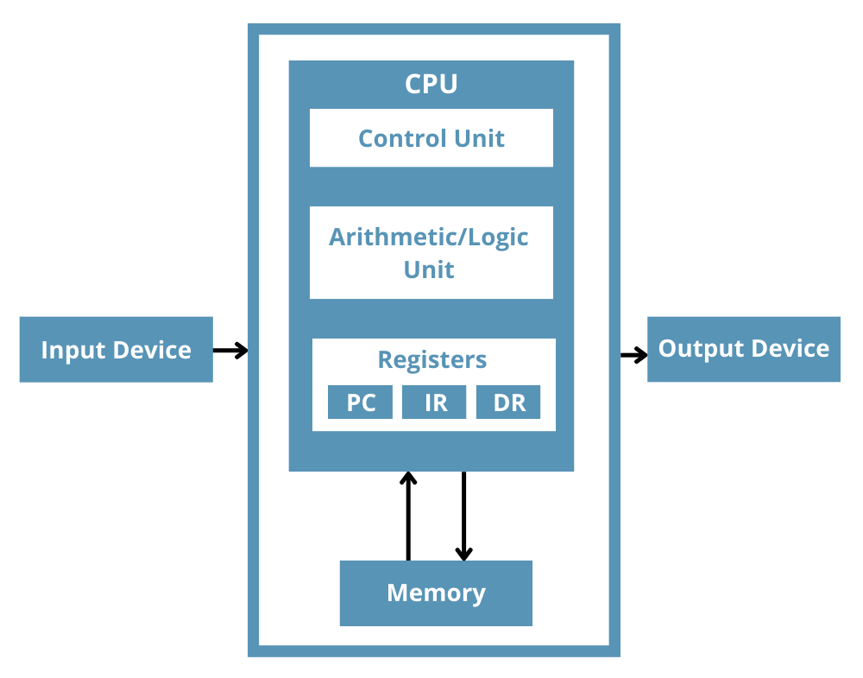
Lecture
SLIDE 4 / 10
General vs Special Purpose Registers
1
General-purpose registers store operands and intermediate results during arithmetic operations.
2
Special-purpose registers hold specific control information like addresses or status flags.
3
The Accumulator (ACC) is a special-purpose register used for arithmetic results.
4
The Program Counter (PC) holds the address of the next instruction to fetch.
5
The Instruction Register (IR) holds the current instruction being decoded and executed.
6
Status registers store condition codes like zero, carry, and overflow flags.
What is a Register in a CPU and How Does it Work? - Total Phase
Chandigarh University
4 / 10
Notes:
Registers are categorized into general-purpose and special-purpose types. General-purpose registers act as temporary storage for data, while special-purpose registers like the PC and IR manage the flow of control. For example, the PC automatically increments after fetching an instruction, ensuring the CPU knows where to go next in the program sequence.

Slide 5
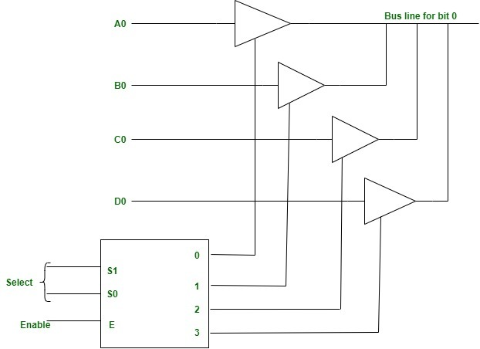
Lecture
SLIDE 5 / 10
The Common Bus System Concept
1
A common bus system connects multiple registers using a shared set of wires.
2
Only one register can transmit data onto the bus at any given time.
3
Multiple registers can receive data from the bus simultaneously via parallel lines.
4
Tri-state buffers control data flow to prevent electrical conflicts on the bus.
5
The bus width equals the number of bits in a single register word.
6
This architecture reduces wiring complexity compared to dedicated point-to-point connections.
Source: media.geeksforgeeks.org
Chandigarh University
5 / 10
Notes:
The common bus system is a shared communication pathway that connects all registers in the CPU. Think of it like a single-lane road where only one car can drive at a time to avoid collisions. Tri-state buffers act as traffic lights, ensuring that only one register drives the bus while others remain in a high-impedance state to prevent short circuits.

Slide 6
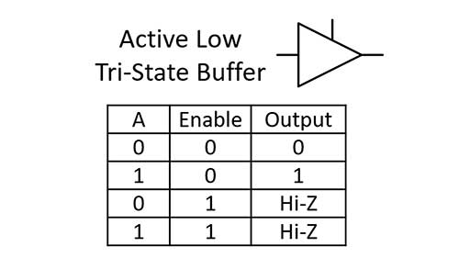
Lecture
SLIDE 6 / 10
Tri-State Buffers and Control Logic
1
A tri-state buffer has three states: logic 0, logic 1, and high impedance.
2
High impedance effectively disconnects the register output from the bus electrically.
3
Control signals like 'Load' and 'Output' determine the buffer state for each register.
4
Only one 'Output' control signal can be active (logic 1) at any time.
5
Multiple 'Load' signals can be active simultaneously to receive data from the bus.
6
The control logic ensures that no two registers drive the bus simultaneously.
Source: www.gsnetwork.com
Chandigarh University
6 / 10
Notes:
Tri-state buffers are the key to managing the common bus without electrical conflicts. When the control signal is low, the buffer enters a high-impedance state, effectively disconnecting the register from the bus. For instance, if Register A is sending data, its output buffer is enabled while all other registers' output buffers are disabled, ensuring a clean signal transfer.

Slide 7
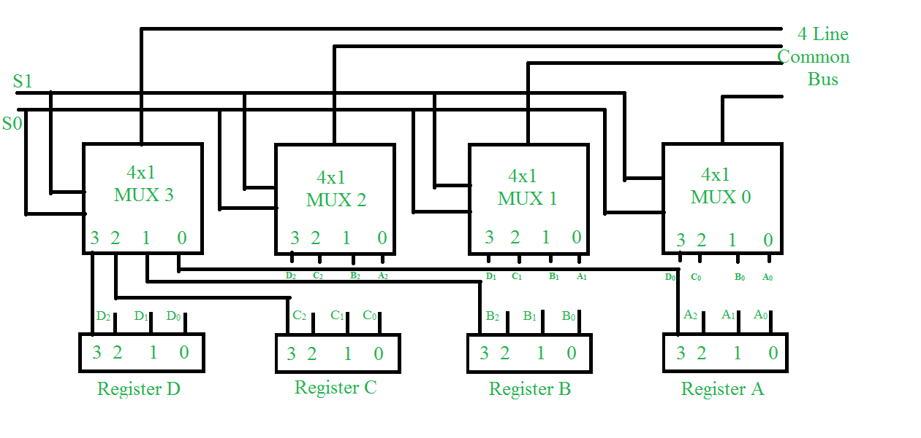
Lecture
SLIDE 7 / 10
Multiplexer-Based Bus Design
1
Multiplexers select one input from multiple sources to route to the bus.
2
A 4-to-1 multiplexer can select data from four different registers for the bus.
3
Selection lines determine which register's data is placed onto the common bus.
4
This design simplifies the control logic by using binary selection codes.
5
The bus output connects to the input of the destination register via a load signal.
6
This configuration allows any register to transfer data to any other register.
Source: media.geeksforgeeks.org
Chandigarh University
7 / 10
Notes:
We can implement the bus selection using multiplexers to choose which register drives the bus. A 4-to-1 multiplexer uses two selection lines to choose one of four inputs, effectively acting as a digital switch. For example, if we want to move data from Register 2 to the bus, we set the selection lines to binary 10, and the multiplexer routes that specific data to the shared bus lines.

Slide 8
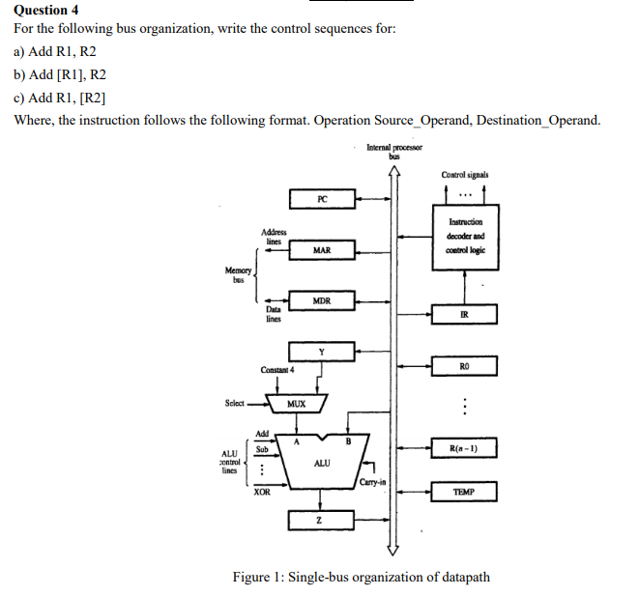
Worked Example
SLIDE 8 / 10
Data Transfer Sequence
SCENARIO
Transfer content of Register R1 to Register R2 using the common bus.
STEP 1
Enable the output buffer of R1 to place data on the bus.
STEP 2
Ensure all other register output buffers are in high-impedance state.
STEP 3
Enable the load input of R2 to capture the data from the bus.
STEP 4
Disable the load input of R2 to complete the transfer operation.
TOTAL TIME
The transfer occurs in one clock cycle if buffers are fast.
Source: media.cheggcdn.com
Chandigarh University
8 / 10
Notes:
Let's walk through a concrete example of transferring data from Register R1 to R2. First, we enable R1's output buffer to drive the bus while keeping others off. Then, we enable R2's load signal to capture the data. This entire sequence happens in a single clock cycle, demonstrating the efficiency of the common bus system for internal data movement.

Slide 9
Lecture
SLIDE 9 / 10
Key Takeaways
1
Registers are classified as general-purpose for data or special-purpose for control.
2
The common bus allows multiple registers to share a single set of wires.
3
Tri-state buffers prevent electrical conflicts by isolating non-transmitting registers.
4
Multiplexers provide a systematic way to select which register drives the bus.
5
Efficient bus design is critical for high-speed data transfer within the CPU.
Source: media.geeksforgeeks.org
Chandigarh University
9 / 10
Notes:
To summarize, we have learned that registers are vital for data storage and control, and the common bus system facilitates their communication. Tri-state buffers and multiplexers are the essential components that make this shared architecture possible without conflicts. Understanding these mechanisms is key to analyzing how modern processors execute instructions efficiently.

Slide 10
Lecture
SLIDE 10 / 10
References
COMPUTER ORGANIZATION AND DESIGN
The Hardware/Software Interface — David A. Patterson, John L. Hennessy
COMPUTER ARCHITECTURE
A Quantitative Approach — John L. Hennessy, David A. Patterson
• Computer Organization and Architecture — William Stallings
• Computer System Architecture — M. Morris Mano & Rajib Mall
• Computer Organization — Carl Hamacher, Zvonko Vranesic, Safwat Zaky
Chandigarh University
10 / 10
Notes:
These five textbooks provide comprehensive coverage of the topics discussed today. I encourage you to consult Stallings and Mano for detailed explanations of register organization. For a deeper quantitative analysis, the works by Hennessy and Patterson are excellent resources. Thank you for your attention, and please review these references for your upcoming assignments.

